Slide 1

SOPHITORIUM MANAGEMENT COLLEGE
SUBJECT NAME-ORGANIZATION BEHAVIOUR

Slide 2
UNIT-1
AN OVER VIEW OF ORGANIZATIONAL BEHAVIOR

Slide 3
To discuss:
1.1. What is organizational behavior?
1.2. The three basic units of analysis in OB
1.3. Replacing intuition with systematic study
1.4. A review of a manager's job and its relation to the study of OB
1.5. The characteristics of OB
1.6. Development of OB
1.7. Contributing disciplines to OB
1.8. Management and OB in the 21st Century
1.9. Organization as a system
1.10. Ethics and Organizational Behavior

Slide 4

What is an organization?
An organization is a consciously coordinated social unit, composed of two or more people that functions on a relatively continuous basis to achieve a common goal or set of goals.

Slide 5

What is organizational behavior?
Organizational behavior is a field of study that investigates the impact that individuals, groups, and structure have on behavior within organization, for the purpose of applying such knowledge toward improving an organizations effectiveness.

Slide 6
What is OB?
Organization Behaviour is the study and application of knowledge about how people act within an organization. It is human tool for human benefit.- Newstrom & Davis
The study of human behavior, attitudes, and performance within an organizational setting
  drawing on theory, methods, and principles from such disciplines as psychology, sociology, political science, and cultural anthropology
  to learn about individual, groups, structure, and processes

Slide 7
LEVELS OF ANALYSIS IN OB
INDIVIDUAL LEVEL
values, attitudes, perception, and learning
the role of personality and emotions
motivation issues
GROUP LEVEL
Ways to make teams more effective
Communication issues and group decision making
Leadership, trust, power, politics, conflict and negotiation
ORGANIZATION LEVEL
Culture, structure, Strategy, Organizational Change

Slide 8
Goals of OB
Explanation
  If we are to understand a phenomenon, we must begin by trying to explain it. We can then use this understanding to determine a cause.
Prediction
  It seeks to determine what outcomes will result from a given action.
Control
  The control objective is frequently seen by manager as the most valuable contribution the OB makes toward their effectiveness on the job.

Slide 9
Are the following questions true or false?
Brainstorming in a group is more effective than brainstorming alone.
If a person fails the first time, they try harder the next time.
The first five minutes of a negotiation don’t matter much.
People perform better if goals are easier.
Most people within organizations make effective decisions.
The best way to help someone reach their goals is to tell them to do their best.
Positive people are more likely to withdraw from their jobs when they are dissatisfied.
If you pay someone to do a task they routinely enjoy, they’ll do it even more often in the future.
Teams with one smart person outperform teams where everyone is average in intelligence.
Pay is a major determinant of how hard someone will work.

Slide 10
Fundamental Principles of OB
Keep workers happy to increase productivity
Maintain transparency in operations.
Adapt ethical practices.
Developing teams to understand each other and contribute to growth of organization
Developing organizational citizenship
Developing quality leaders
Adapting learning organization concept and help employees accept changes in organization.

Slide 11
Principles of OB
OB is a way of thinking
OB is multidisciplinary
There is a distinctly humanistic orientation within OB
The field of OB is performance-oriented
The role of the scientific method is important in studying variables and relationships
OB has a distinctive applications orientation

Slide 12

Focal Points of OB
Jobs
Work
Absenteeism
Employment turnover
Productivity
Human performance
Management

Slide 13
Goals of OB:
Systematically describe how people behave under a variety of conditions
To understand why people behave as they do
To predict future employee behaviour
To control and develop human activity at work

Slide 14
Challenges and Opportunities for OB
1.Responding to Globalization
  Increased foreign assignments
  Working with people from different cultures
  Coping with anticapitalism backlash
  Overseeing movement of jobs to countries with low-cost labor
  Managing people during the war on terror

Slide 15
2.Managing workforce diversity
  Workforce diversity:
    Gender, race, national origin, age, disability,
  Embracing diversity
  Changing demographics
Workforce diversity can increase creativity and innovation in organizations as well as improve decision making by providing different perspective on working as a team.

Slide 16
3.Improving quality and productivity
  “Almost all quality improvement comes via simplification of design, manufacturing, layout, processes, and procedures.”----Tom Peters
  Today’s managers understand that success of any effort at improving quality and productivity must include their employees.

Slide 17
4.Improving people skills
We’ll present relevant concepts and theories that can help you explain and predict the behavior of people at work.
  Learn a ways to motivate people
  How to be a better communicator
  How to create more effective teams

Slide 18
5.Empowering people
  Decision making is being pushed down to the operating level, where workers are being given the freedom to make choices about schedules and procedures and to solve work-related problems.
  Self-management team
  Managers are empowering employees.
  Managers-how to give up control
  Employees-how to take responsibility for their work and make appropriate decisions
  Leading style, power relationships, the way work is designed, the way organizations are structured

Slide 19
6.Stimulating innovation and change
  Today’s successful organizations must foster innovation and master the art of change or they’ll become candidate for extinction.
  An organization’s employees can be the impetus for innovation and change or they can be a majors stumbling block.
  The challenge for managers is to stimulate their employees’ creativity and tolerance for change.

Slide 20
7.Coping with “temporariness”
  Managing today would be more accurately described as long periods of ongoing change, interrupted occasionally by short periods of stability!
  The actual jobs that workers perform are in a permanent state of flux.
  So workers need to continually update their knowledge and skills to perform new job requirements.

Slide 21
8.Helping employees balance work/life conflicts
  A number of forces have contributed to blurring the lines between employee work and personal lives.
  First, the creation of global organizations means their world never sleeps.
  Second, communication technology allows employee to do their work at home, in their car, or on the beach in Goa.
  Third, organizations are asking employees to put in longer hours.
  Finally, fewer families have only a single breadwinner.

Slide 22
9.Declining employee loyalty
  Beginning in the mid-1980s, in response to global competition, unfriendly takeovers, leveraged buyouts, and the like, corporations began to discard traditional policies on job security, seniority and compensation.
  An important OB challenge will be for managers to devise ways to motivate workers who feel less committed to their employers, while maintaining their organizations’ global competitiveness.

Slide 23
10.Improving ethical behavior
  Members of organizations are increasingly finding themselves facing ethical dilemmas, situations in which they are required to define right and wrong conduct.
  In recent years, the line differentiating right from wrong has become even more blurred.
  Managers and their organizations are writing and distributing codes of ethics to guide employees through ethical dilemmas.

Slide 24

Implications for Managers
OB helps with:
  Insights to improve people skills
  Valuing of workforce diversity
  Empowering people and creating a positive work environment
  Dealing with labor shortages
  Coping in a world of temporariness
  Creating an ethically healthy work environment

Slide 25
Contributing Disciplines to the OB Field
Psychology
Social Psychology
Sociology
Anthropology
Micro:
The Individual
Macro:
Groups &
Organizations

Slide 26
Psychology----individual
  learning, motivation, personality, emotions,
  perception, training, job satisfaction, leadership effectiveness,
  individual decision making, performance appraisal, attitude measurement, employee selection,
  work design, work stress
Social psychology----group
  Behavioral change, attitude change,
  communicate,
  group processes,
  group decision making

Slide 27
Sociology
  Communication, power, conflict, intergroup behavior, ----group
  formal organization theory,
  organizational technology,
  organizational change,
  organizational culture ----organization system

Slide 28
Anthropology
  Comparative values,
  comparative attitudes,
  cross-culture analysis, ----group
  organizational culture,
  Organizational environment,
  Power ----organization system
Political science
  Conflict,
  Intra organizational politics, ----group
  Power ----organization system

Slide 29
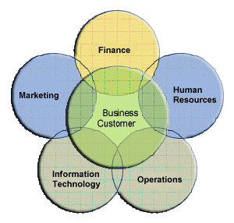
ORGANISATION AS A SYSTEM
The organization is a system - made up of components which
work together to achieve an overall goal.
Systems approach to OB views the organization as a united, purposeful
system composed of interrelated parts.
This approach gives managers a way of looking at the organization as a whole, whole person, whole group, and the whole social system.

Slide 30
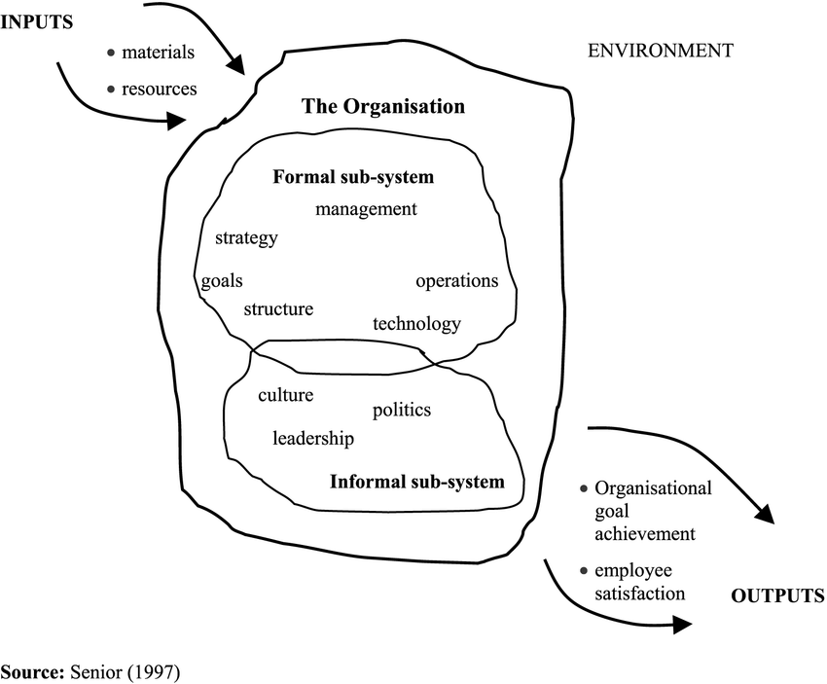
System approach to Organizational Behaviour

Slide 31
Model of the Business Professional for the 2021
• Strong functional expertise: technical proficiency and cross-functional awareness.
• Ability to work in an unstructured, team environment.
• Interpersonal competency and diversity-related skills.
• Excellent negotiating and influencing skills.
• Outstanding information technology skills: PC/computer, internet and intranet.
• Global/transnational perspective.
• Exceptional verbal (oral and written) communication skills.
• Critical thinking and analysis capabilities.
• Ability to consistently deliver high performance.
• Change agent skills and leadership capabilities

Slide 32
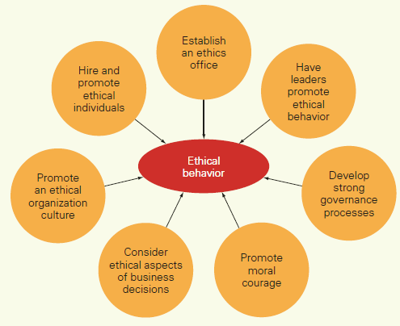
Ethics and Organizational Behaviour

